Slide 1
Diabetic Retinopathy Detection Using Deep Learning and Image Processing
Group Members:
Khwaja Wisal Maqsood(16BCS078).
Manoj (16BCS026).
Minor Project Presentation.

Slide 2
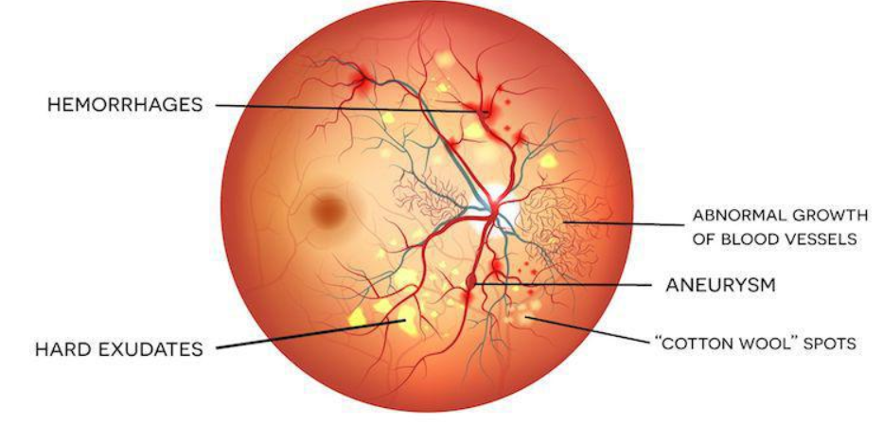
Diabetic Retinopathy Detection and Grading Using Deep Learning and Image Processing

Slide 3
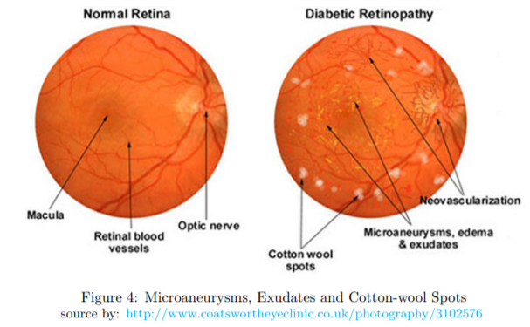
What is Diabetic Retinopathy? How does it affect the population and diagnosis.
Diabetic Retinopathy is a direct consequence of inconsistent and uncontrolled level of blood sugar which results in damage to the blood vessels of the light-sensitive tissue at the back of the eye (retina) causing blindness usually if detected early treatment is possible otherwise laser surgeries are used although the damaged caused to retina in case of severe retinopathy is not completely reversible but in 95% cases it is treatable[1][2].
The longer one takes for treatment the more damage is caused and in some cases the blindness is permanent this is due to the fact that At first, diabetic retinopathy may cause no symptoms or only mild vision problems. Eventually, it can cause blindness[1][2].
The condition generally develops amongst people suffering from type-1 or either type-2 diabetes. The longer one has diabetes and the less controlled your blood sugar is, the more likely you are to develop this eye complication[1][2].

Slide 4
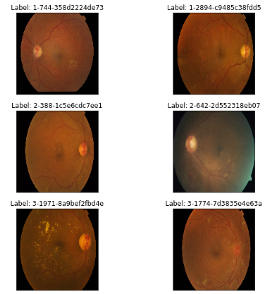
Diabetic Retinopathy Detection and Diagnosis.
Diabetic retinopathy is usually diagnosed by an ophthalmologist and graded into 5 categories as shown:
0-No DR.
1-Mild DR.
2-Moderate DR.
3-Severe DR.
4-Proliferative DR.
This grading scheme was designed to tackle the earlier complex procedure for scaling DR diagnosis which was also known as ETDRS(Early Treatment of Diabetic retinopathy Study).
Due to the complexity of ETDRS a new scale was adopted which was easy to understand and implement and also improved diagnosis, this came to be known as the INTERNATIONAL CLINICAL DISEASE SEVERITY SCALE FOR DR [1][2][6].

Slide 5
Existing Work and Detection Systems based on Deep Learning
S.NO | Authors | Year | Technique | Quadratic weighted kappa | AUC-ROC Metric | Dataset Used
1 | Varun Gulshan, PhD; Lily Peng, MD, PhD; Marc Coram, PhD; Martin C. Stumpe, PhD; Derek Wu, BS; A | 2016 | Inception V-3. | 0.8851(5) | 0.991(3 vs All), 0.993(Avg-AUC across all datasets) | Eyepacs-1(15,000, Messidor-2(2000), Google’s own DB-1,20,000, APTOS(13000)
2 | Daniel Shu Wei Ting, MD, PhD^{1,2}; Carol Yim-Lui Cheung, PhD^{1,3}; Gilbert Lim, PhD⁴; et al | 2017 | Inception V-3 and V-4 + CLAHE | 0.856(5) | 0.971( 4 vs all), Avg AUC-0.951 | Eyepacs-2(76000),Messidor-2(200)
3 | Bellemo, Valentina, et al. | 2019 | VGG-net | 0.831(3) | 0.973(2 vs all) and | Eyepacs-2,and Zambian eye scociety(18000)
4 | Wei Zhang, Jie Zhong, Shijun Yang, Zhentao Gao | 2019 | Two Part ensemble. 1-binary classification then, 2- grading Sytem. 1-Xception,Resnet-50,Inception resnet-v2. | 0.8771(4) | 0.981(Classification), 0.994( Avg-AUC) | Sichuan Medical Center(15000)

Slide 6
Datasets Used
For this Project we selected Open- Sourced datasets that have been made publicly available:
The First dataset we took from Eyepacs the Eyepacs - 2 dataset containing 84,000 images of 41,254 patients.
Eyepacs - 1 dataset from Kaggle as part of DR detection competition 5 years ago. It Contains 1,20,000 images.
APTOS DR detection Competition, a kaggle dataset now made publicly available by Aravind Eye care, It consists of 8,000 images.
Messidor-2 dataset, It consists of 2000 images.
All the images used are Retino-fundal images with a fixed resolution of 1024 x 1024 for all the images i.e in total we have 2,14,000 retino-fundal images of the retina which have already been graded by opthamologists into 5 categories of DR which are as follows:
0-No DR.
1-Mild DR.
2-Moderate DR.
3-Severe DR.
4-Proliferative DR.
We train our models on 1,50,000 images then further fine tune the models using 40000 images. We validate our models on the remaining 15000 images. We finally test our models on the remaining 13,000 images using Test Time Augmentation.

Slide 7
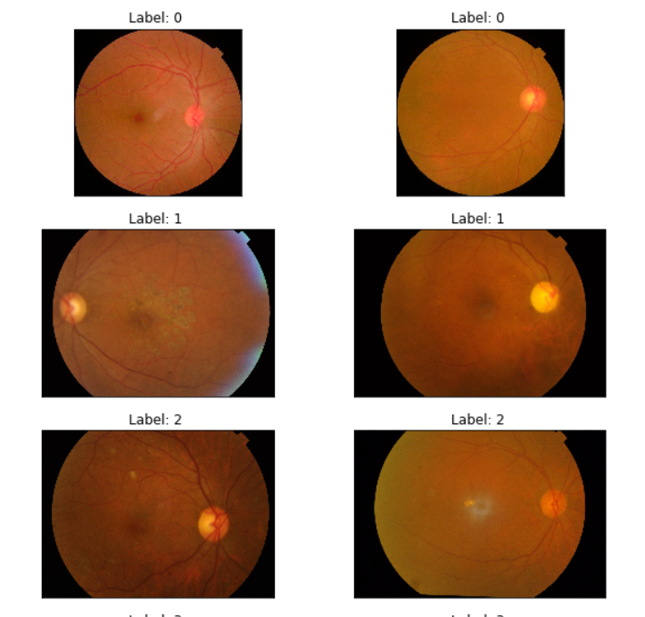
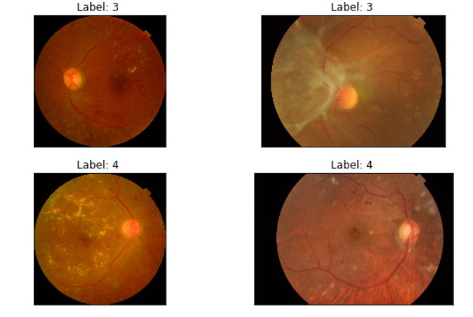
Dataset Description and Anomalies

Slide 8
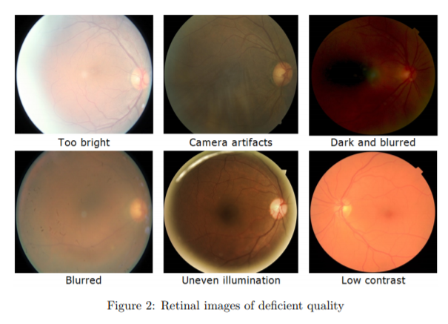
Anomalies in the dataset

Slide 9
Image Preprocessing and Techniques
We used a variety of Image processing techniques to improve model performance which are as follows:
Median Subtraction.
Gamma Correction.
Adaptive histogram Equalization.
Ben Grahams’s Image Processing applied to black and white as well as Colour images.

Slide 10
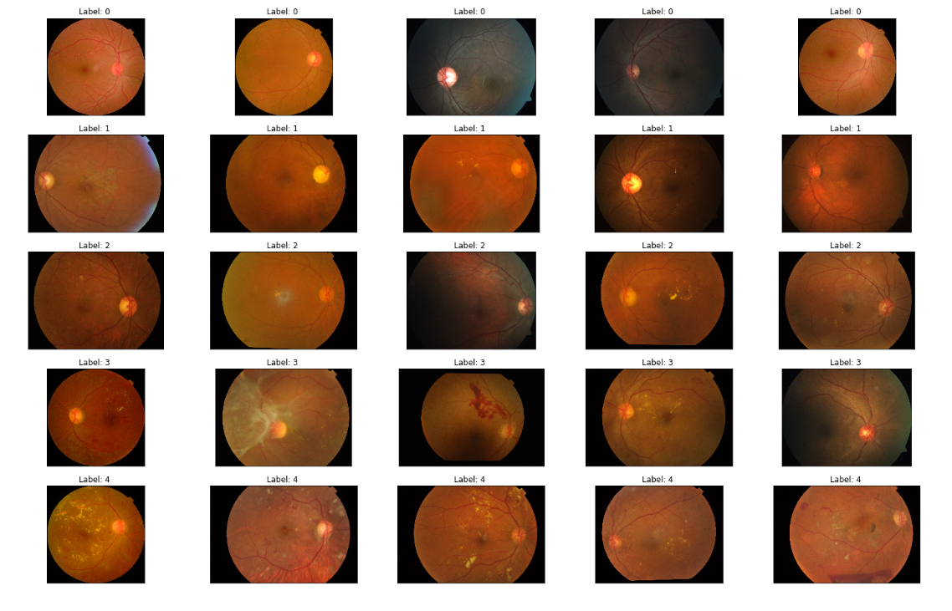
Median Subtraction:
Original Image:

Slide 11
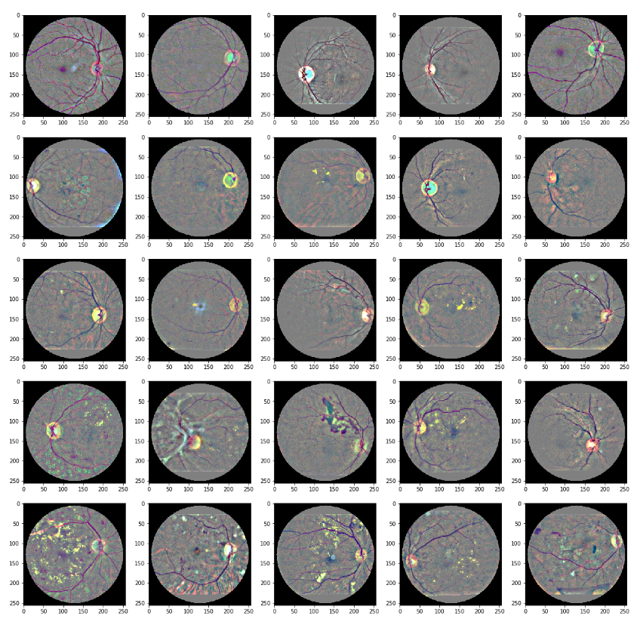
Preprocessed images after applying median Subtraction:

Slide 12
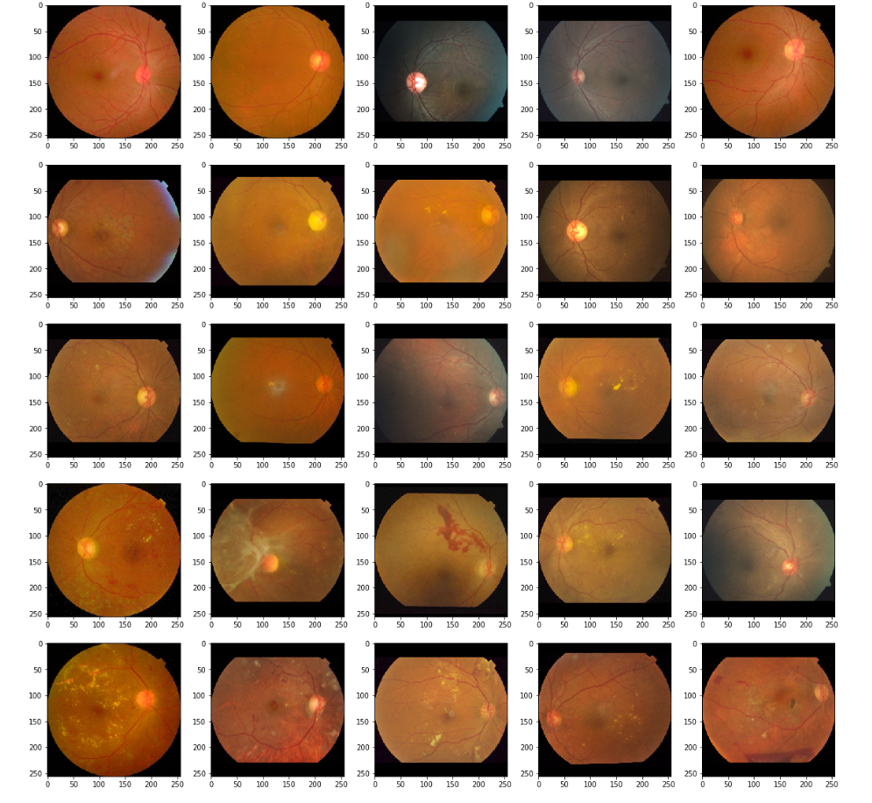
Preprocessed images after applying Gamma Correction:

Slide 13
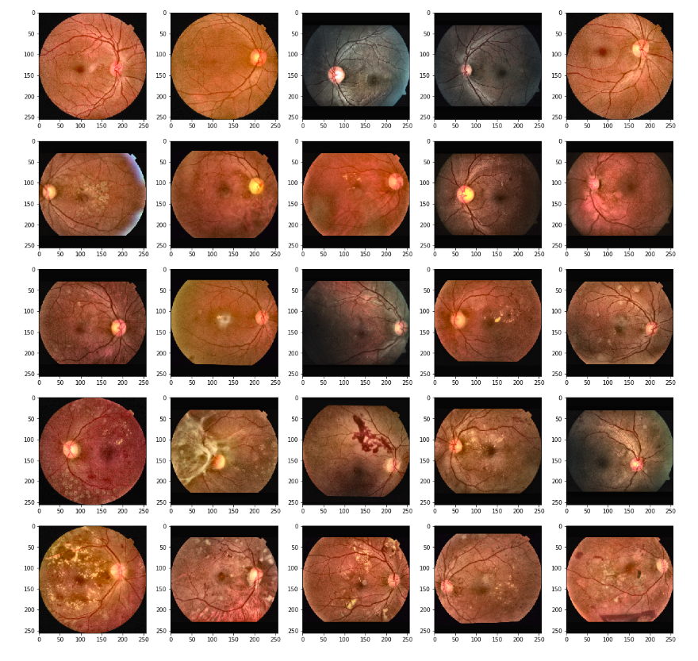
Preprocessed Image after Applying Adaptive Histogram Equalization:

Slide 14
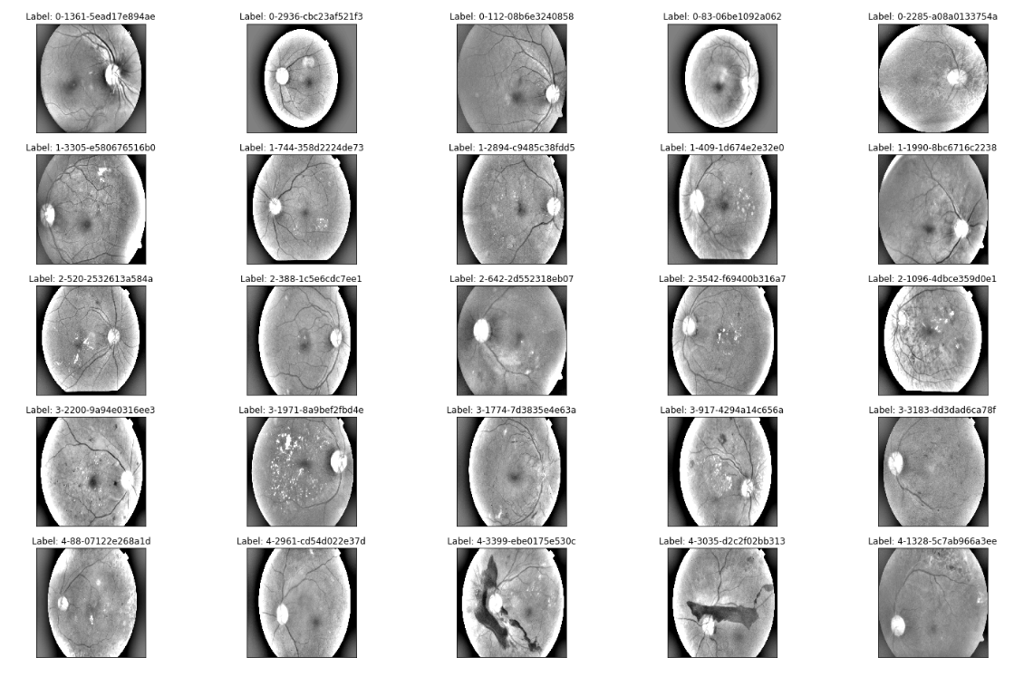
The Magic: Ben Graham’s Image Preprocessing, It is a preprocessing method developed by Ben Graham in 2015 as part of then Eyepacs DR Detection Competition, Since then this has been adopted as the world-wide standard for image preprocessing of Retino-Fundal Images.

Slide 15
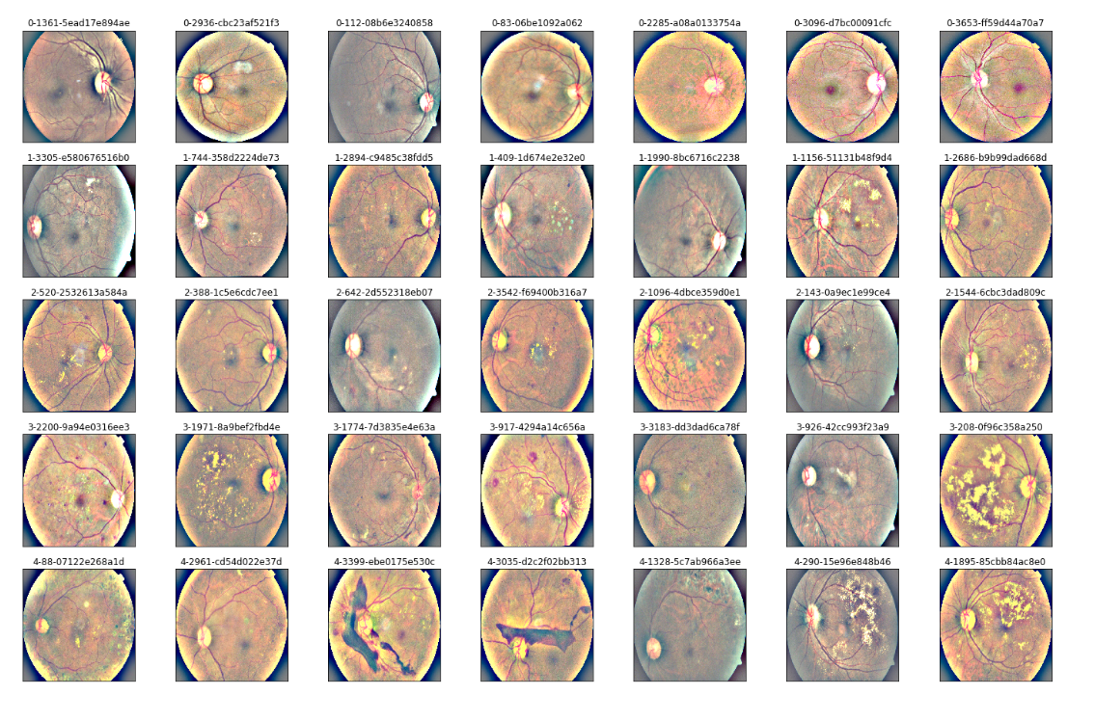
Preprocessed Colour images using Ben Graham’s Technique,
Eyepacs 1

Slide 16
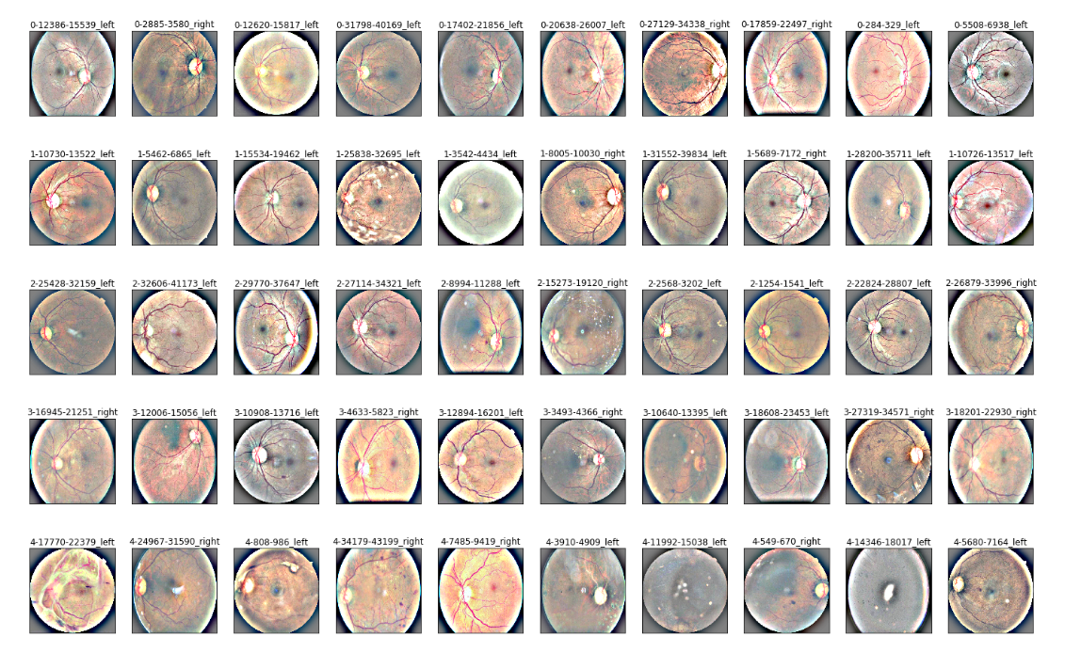
Preprocessed Colour images using Ben Graham’s Technique,
Eyepacs 2

Slide 17
Transfer Learning
The aim of this study is to produce a Robust model for DR detection over the 5 classes to produce a model which is robust as well as is able to generalize well when faced with different kinds of images taken in different conditions with different kinds of devices.
All the works stated earlier are based on deep learning models and they generally use Precision,Recall,Specificity and sensitivity as metrics to measure and compare the performance of the produced model.In this study, our main focus will be to optimize AUC,and more specifically Quadratic Weighted Kappa or QWK.Quadratic Weighted Kappa or QWK has been one metric ignored by quite a few researchers because Quadratic Weighted Kappa or QWK obtained in DR detection usually is quite less around 0.83-0.88 and as this is a multi-class classification problem QWK is a metric that gives very accurate measure becasue simply of the fact how it calculates the score e.g if model predicts the class as 4 but the actual class is 3 penalty will be less in that proportion but if actual class is 0 and model predicts 4 we are way off and penalty on the QWK is proportional to this.
Thus QWK has now been made a standard by eyepacs and many organisations to measure the Robustness of the Models produced for the task of DR detection and has also been used as a metric to evaluate various other models giving a uniform scale to measure other model performance as well as its robustness and generalization capabilities.
For this task we have used the following models:
As it is already known transfer learning does give really good results when done sensibly, so our starting approach was to try out pre-trained models which included:
Resnet 50,EfficientNet B5,B6,B4,B7,Res-Next 32x4d.
Finally we produce an ensemble of all the above models.

Slide 18
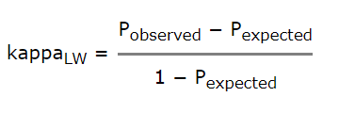
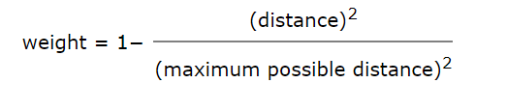
Quadratic Weighted Kappa
Kappa is Chance adjusted index for reliability of categorical measurements. This means that, it accounts for amount of agreement between raters that can be expected to have occurred due to chance (i.e., random guessing). This is unlike accuracy where you can get relatively fair score by intelligently random guessing. Here 3 matrices are involved:
N×N(N is number of categories) histogram matrix O, where each element eij of O corresponds to the number of observations that received a category i by A and a category j by B. In our case, N=5 so O is 5×5 matrix. Each element eij will represent count of images that recieved category i by A(say human) and category j by B(our models). So greater the number in diagonal, greater good.
N×N weights matrix W, where each element is calculated using distance between ratings. More on this later.
N×N histogram matrix of expected ratings E, which is calculated as the outer product between each rater's histogram vector of ratings. E is normalized so that E and O have the same sum. Now, each cell in O is multiplied by corresponding cell in W and sum the results across all the cells. Call this Po. Same is done for E. Call this Pe. Then kappa is calculated as below:

Slide 19
Training, Validation and Testing:
We Train all the Pretrained models again on 150000 images by unfreezing the weights in the backbone layers of the Network.
We Trained the following models:
Efficientnet B7,B6,B5,B4.
Resnet 50.
Resnext 32x4d.
For all the models Following Data Augmentations were used:
do_flip
flip_vert
Max_zoom.
Rotate-60,90,120.
Differential Learning rates were used using FAST.AI API and its Learner function.
We used RAdam as the Optimizer.
Batch Size for Efficient Nets was kept at -84 and for Resnets-120 and for resnext-124.
All the Images were Resized to 3 image categories as part of the Technique called Progressive resizing as follows:
240,360,440
All the models were each trained on images with 240 the 360 and 440 thus in total 3 models for each model hence in total 18 models . 1 model is trained across all the three image sizes to complete its training.

Slide 20
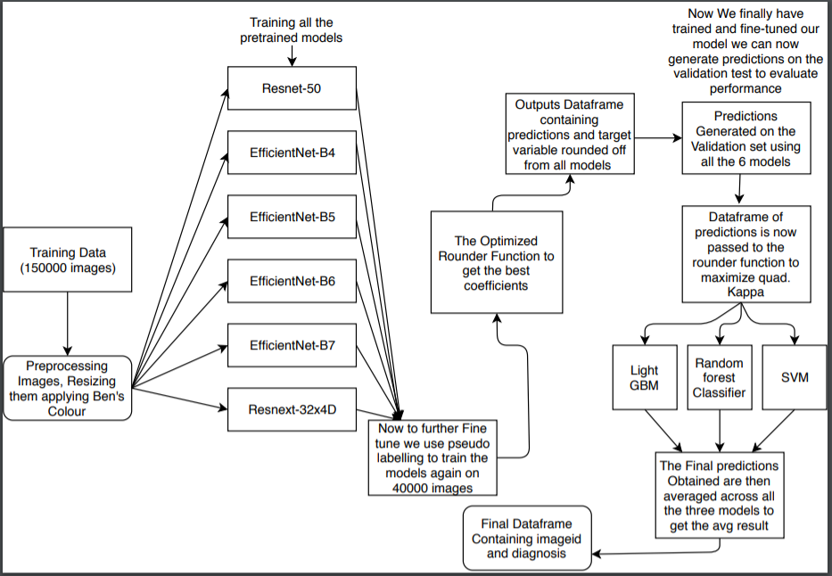
The proposed Model Framework

Slide 21
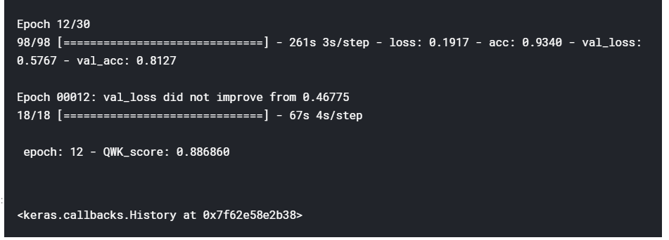
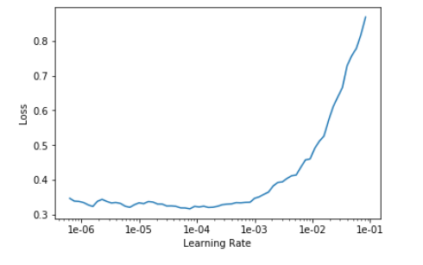
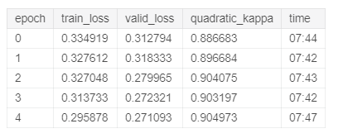
Resnets and Results

Slide 22
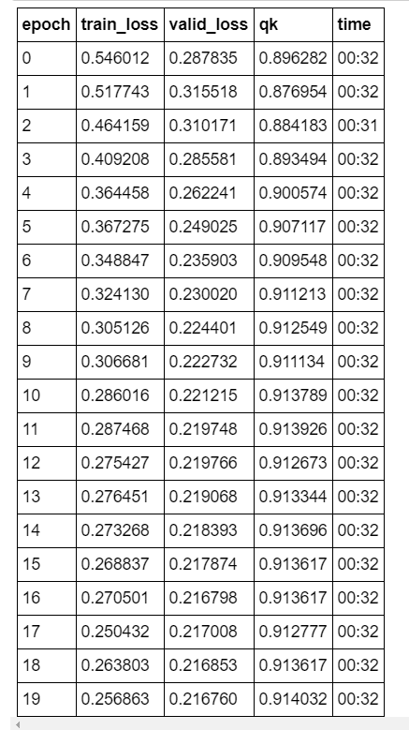
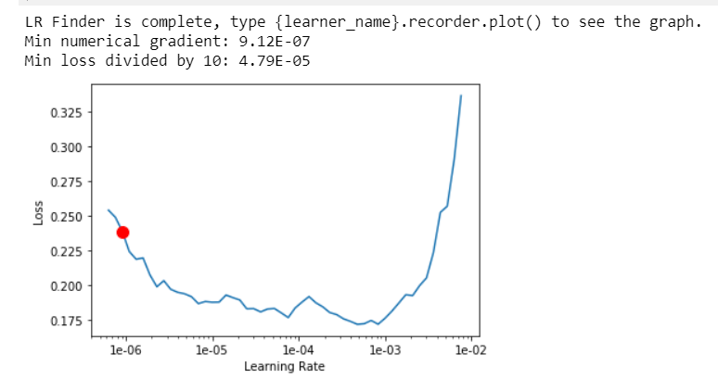
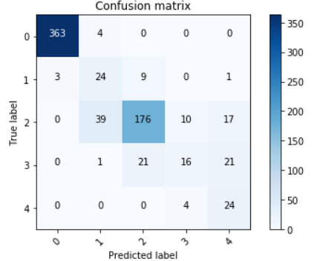
Efficientnet-B4 Results

Slide 23
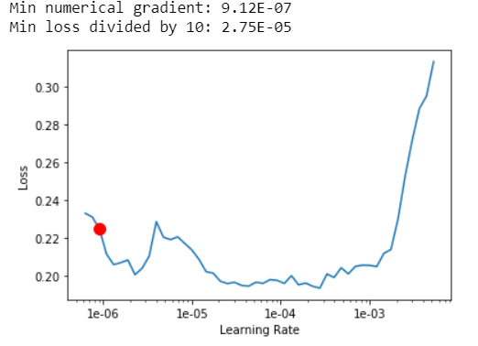
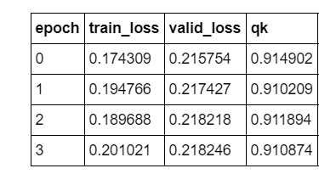
EfficientNet-B5 Results

Slide 24
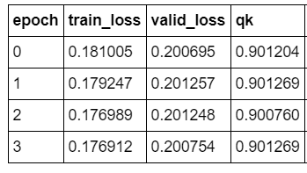
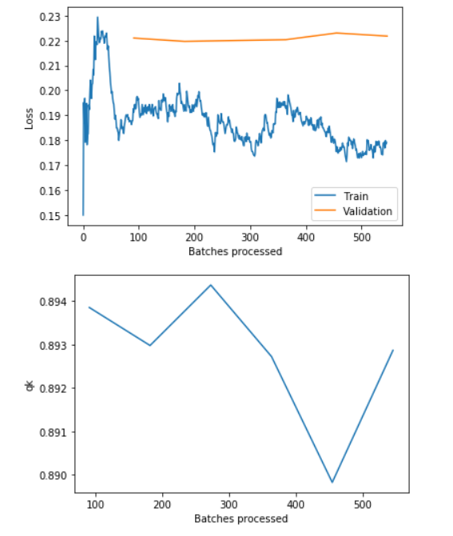
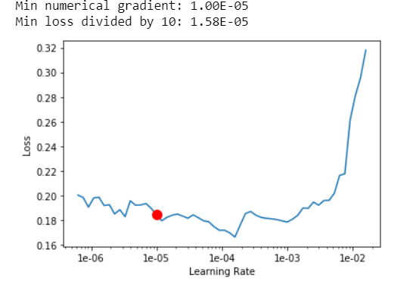
EfficientNet-B6 Results

Slide 25
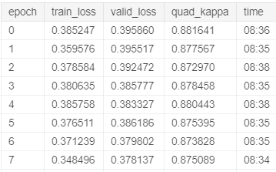
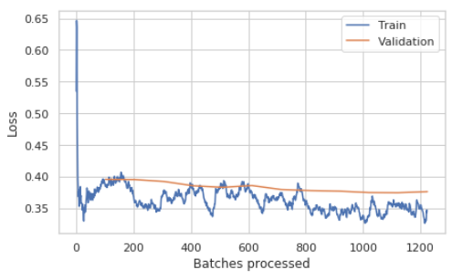
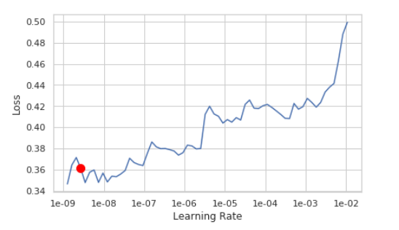
Res-Next 32x4D Results:

Slide 26
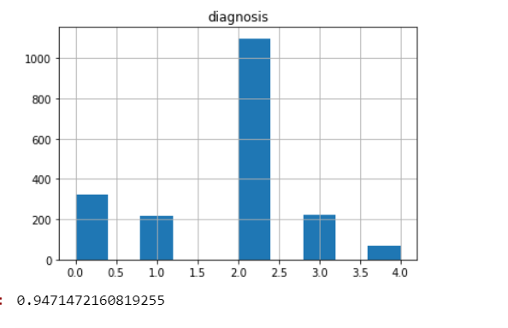
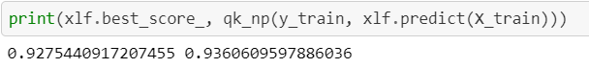
Final Predictions and Results
Final predictions on the Test set and Quadratic kappa value.
Quadratic kappa
Quadratic kappa and best score by stacking efficientnet B5,B6,B7,B4.
1st value indicates avg quad kappa just using LGbm and the2nd value is avg quad kappa using LGbm,SVM .

Slide 27
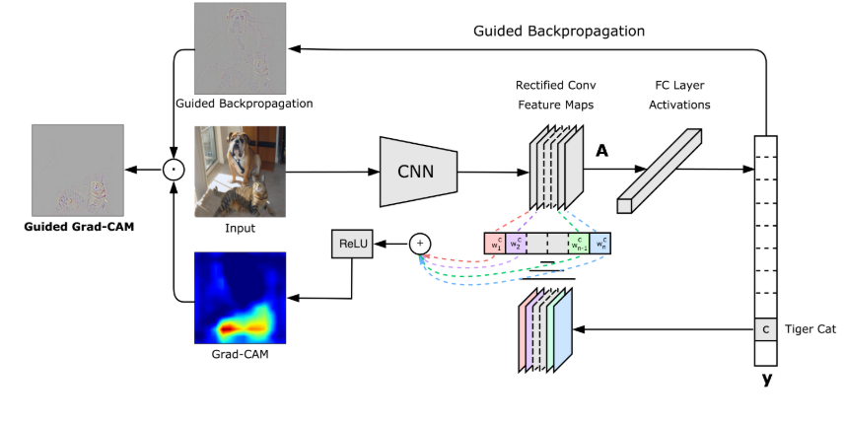
Model Interpretation and Analysis
Results are great but what is our model actually seeing. Interpreting and analysing the model is one of the most important aspects of creating a robust model that generalizes well because we need to understand where our model is failing and why. So for this we use a technique called GRAD-CAM which was engineered by researchers to understand the activation values of feature maps in the last Convolutional layer just before Pooling is applied.

Slide 28
GRAD-CAM(Gradient-Weighted class actvation mapping).
Basic idea behind GRAD-CAM:
We believe that most important spatial information come from the 3D-tensor of the last convolutional layer (just before GlobalPooling layer), which is the nearest spatial information flowing to the last FC layer.
For each channel of this 3D-tensor, each activated pixel region represent important features (e.g. blood vessel / scab / cotton wool) of the input image. Note that some features are important to determine class 0 (perfectly fine blood vessel), some features are important to determine class 4 (big cotton wools). Normally, we expect each channel to capture different set of features
To emphasize features which finally affected the final prediction, we calculate the gradient of the final predicted class with respect to each feature. If that feature is important to this class, it should have high gradient (i.e. increase the value of this feature, the prediction confidence increases)
Therefore, we multiply the activated values of this 3D-tensor and gradients together, to obtain the visualized heatmap for each channel. Note that we have multi-channels, and each channel usually have multi-features.
Finally, we combine heatmaps of all channels using simple average, and remove negative value (the ReLu step in the above picture) to obtain the final heatmap.

Slide 29
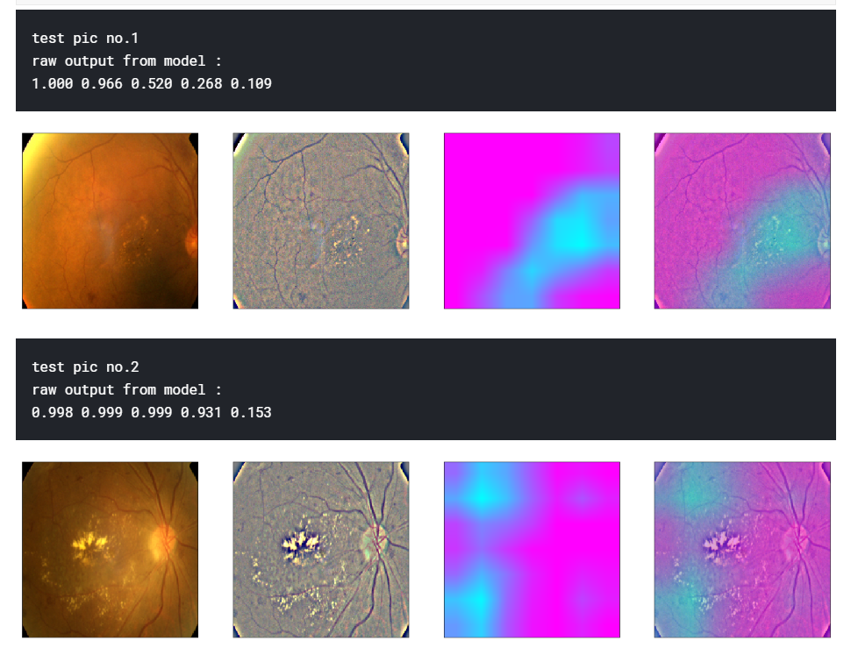
GRAD-CAM analysing Resnets

Slide 30
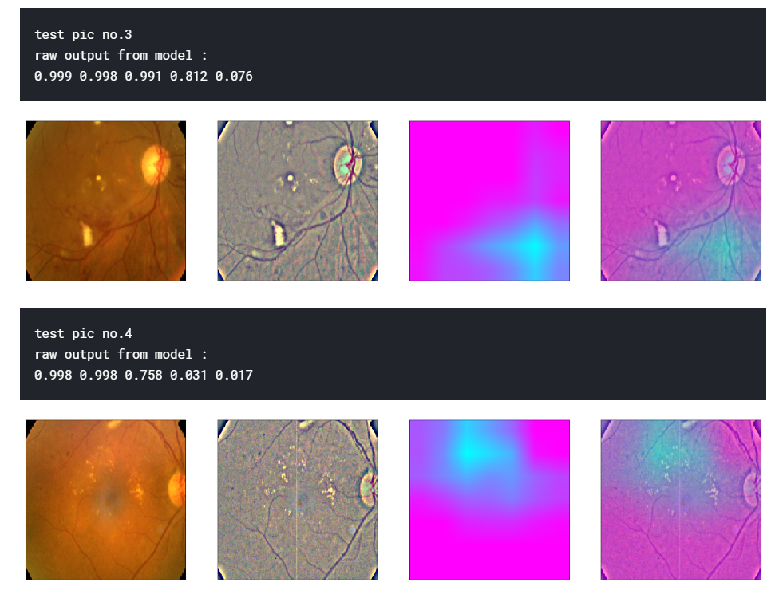
GRAD-CAM analysing Resnets

Slide 31
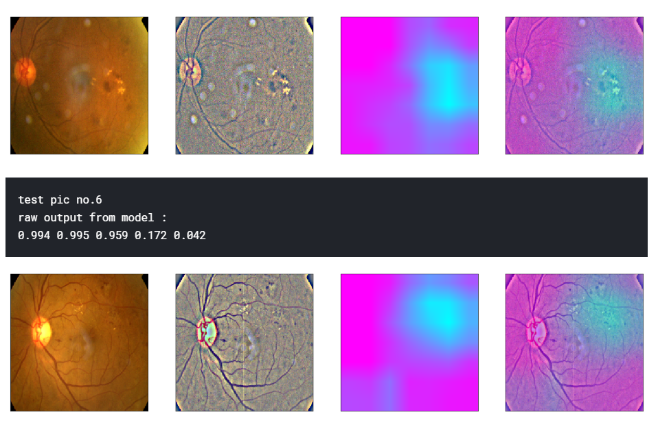
GRAD-CAM analysing Efficient-Net and its efficiency

Slide 32
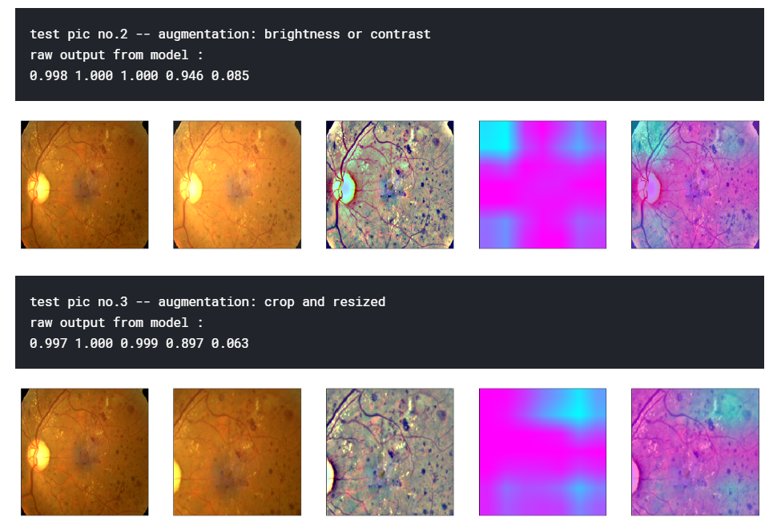
Analysing efficientnet with augmentations

Slide 33
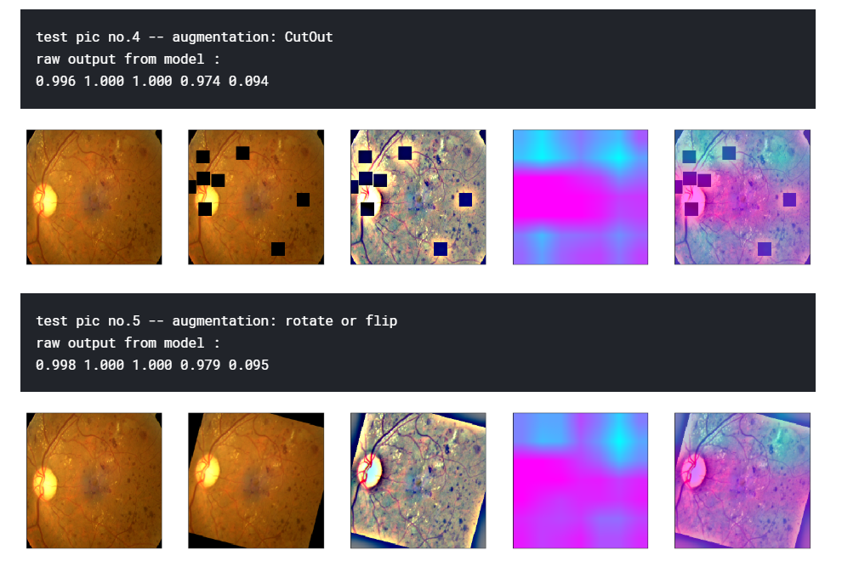
Analysing efficientnet with augmentations

Slide 34
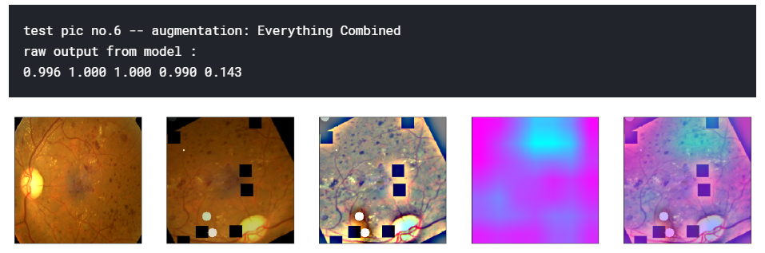
All augmentations and Analysis

Slide 35
Final Results:
S.NO | Authors | Year | Technique | QWK | AUC-ROC Metric | Dataset Used
1 | Varun Gulshan, PhD; Lily Peng, MD, PhD; Marc Coram, PhD; Martin C. Stumpe, PhD; Derek Wu, BS; A | 2016 | Inception V-3.+image processing. | 0.8851(5) | 0.991(3 vs All), 0.993(Avg-AUC across all datasets) | Eyepacs-1(15,000, Messidor-2(2000), Google’s own DB-1,20,000, APTOS(13000)
2 | Daniel Shu Wei Ting, MD, PhD^{1,2}; Carol Yim-Lui Cheung, PhD^{1,3}; Gilbert Lim, PhD⁴; et al | 2017 | Inception V-3 and V-4 + CLAHE | 0.856(5) | 0.971( 4 vs all), Avg AUC-0.951 | Eyepacs-2(76000),Messidor-2(200)
3 | Bellemo, Valentina, et al. | 2019 | VGG-net | 0.831(3) | 0.973(2 vs all) and | Eyepacs-2(71000),and Zambian eye society(18000)
4 | Wei Zhang, Jie Zhong, Shijun Yang, Zhentao Gao | 2019 | Two Part ensemble. 1-binary classification then, 2- grading Sytem. 1-Xception,Resnet-50,Inception resnet-v2. | 0.8771(4) | 0.981(Classification), 0.994( Avg-AUC) | Sichuan Medical Center(15000)
5 | Khwaja Wisal, Manoj | 2019 | EfficientNet+Resnet+Resnext+SVM+LGBM+RF+Image Processing+Pseudo labelling. | 0.9417(5) | 0.9971(4 vs all) 0.9959(avg AUC) | Eyepacs 1(120000) Eyepacs 2(84000) Messidor-2(2000) APTOS(8000)

Slide 36
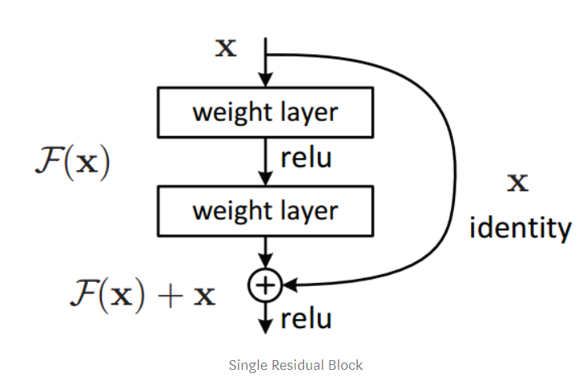
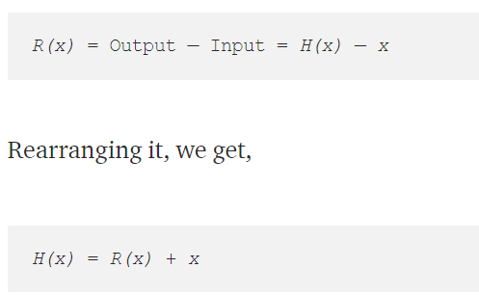
Understanding Resnets.

Slide 37
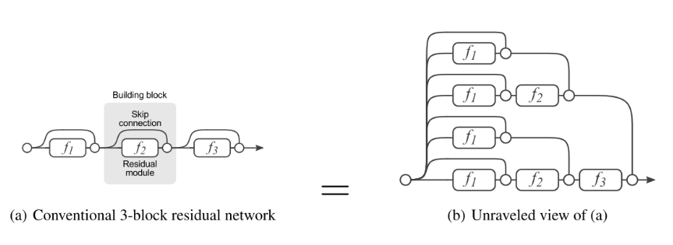
Resnets are residues forming Ensembles!!!!!!
For a N-block Residual Network there are 2 to the power N paths for the gradients to flow.

Slide 38
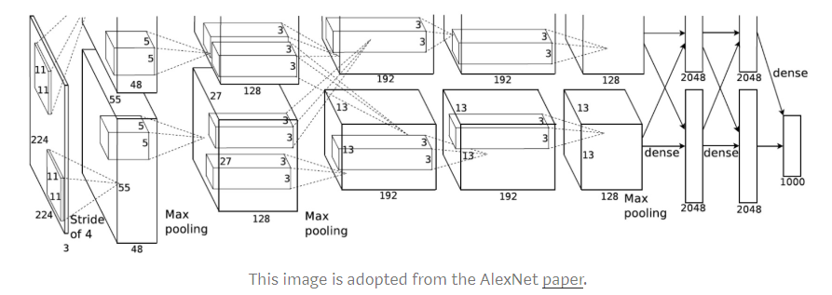
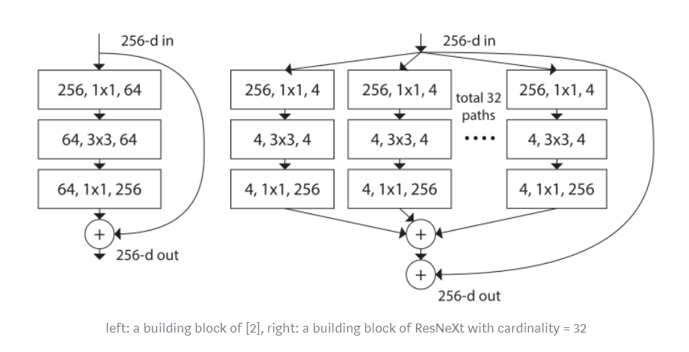
Understanding Resnext:

Slide 39
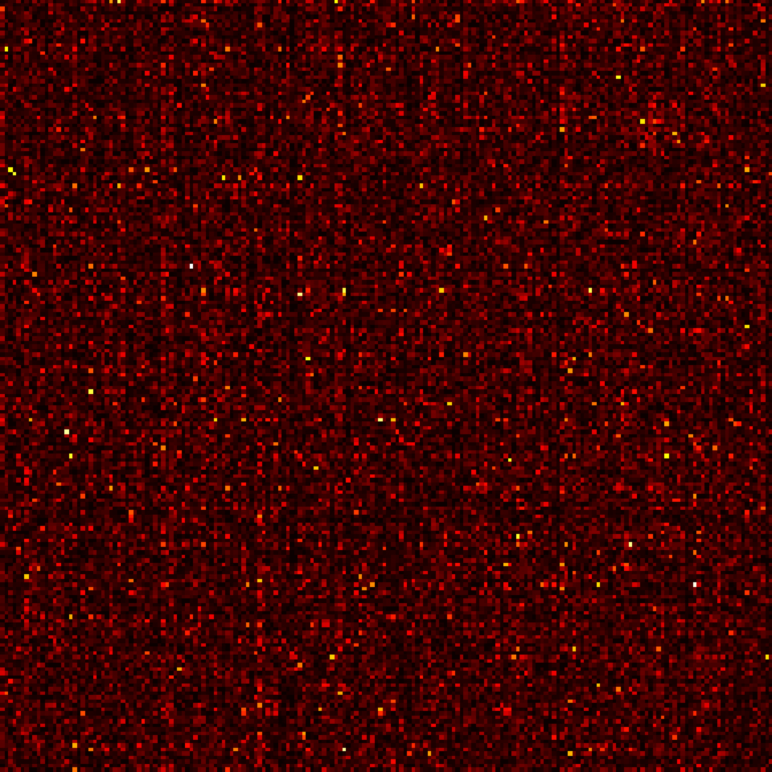
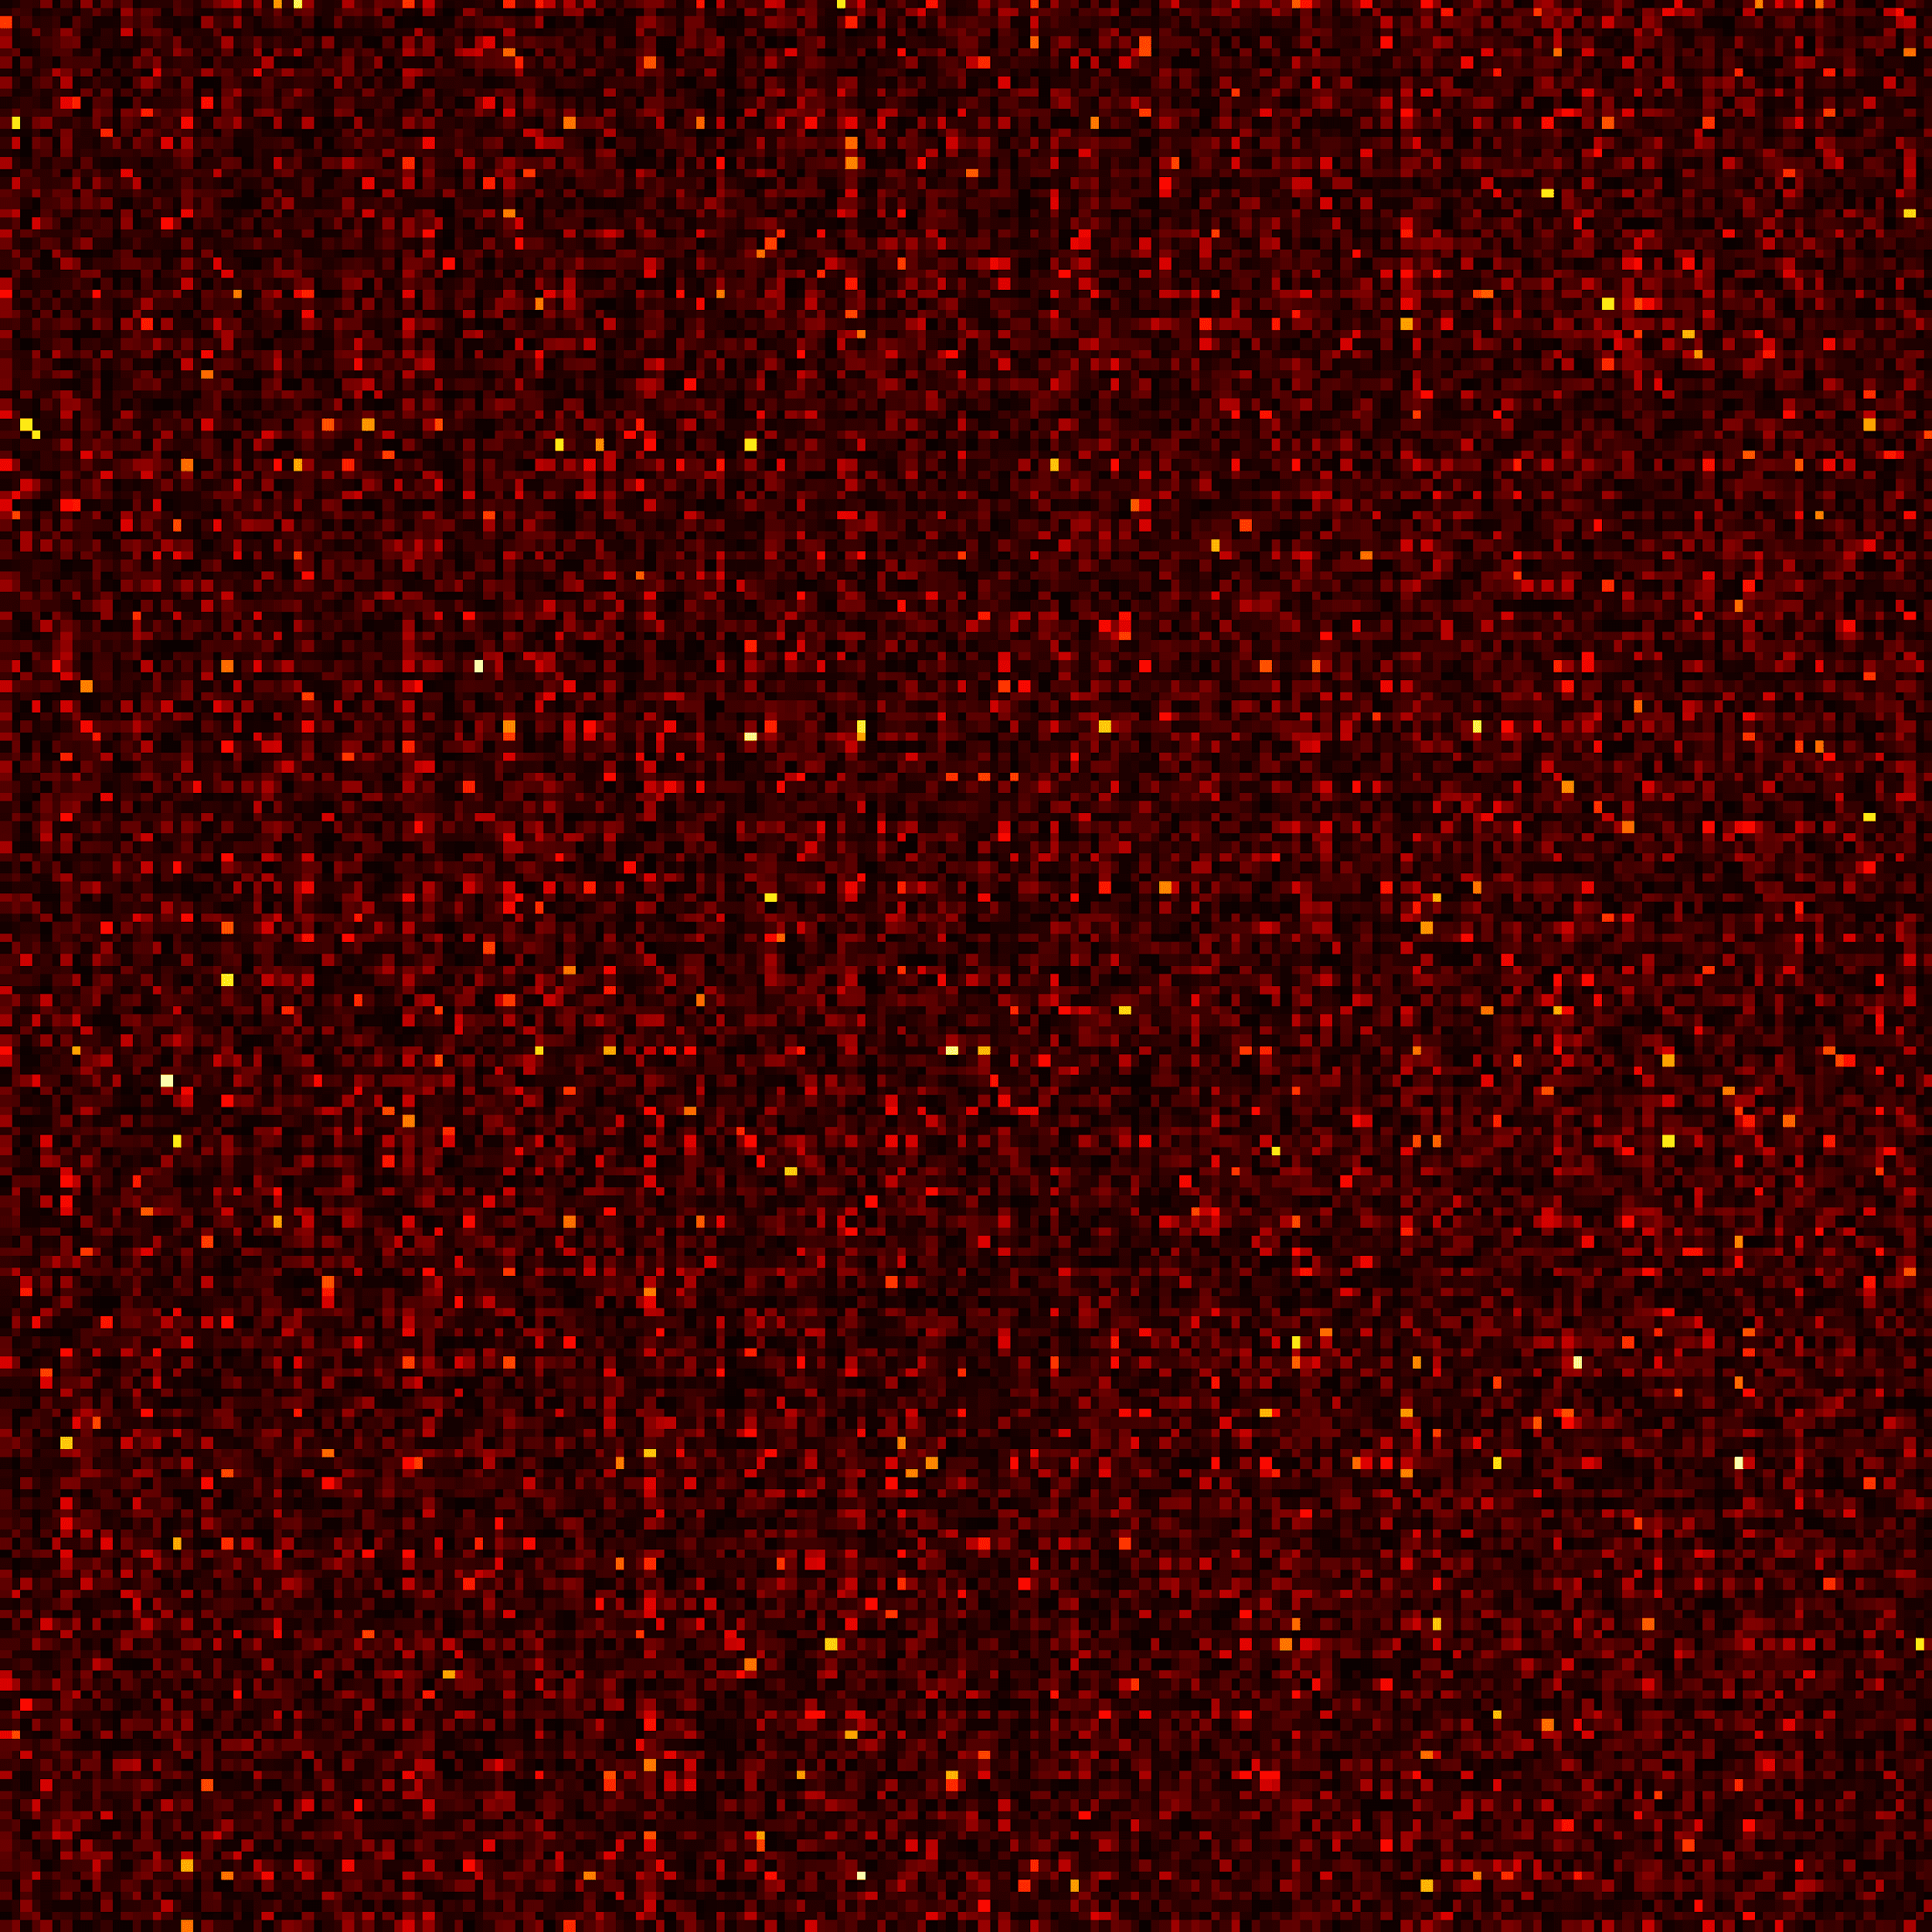
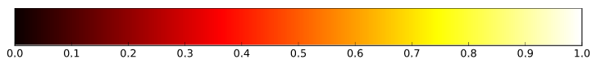
Why Grouping?
Correlations Between Learned Filters of a Resnext network with groups of 1,2,4,16 Filter Groups
Correlations Between Learned Filters of a Resnet network with no Grouped Convolutions.

Slide 40
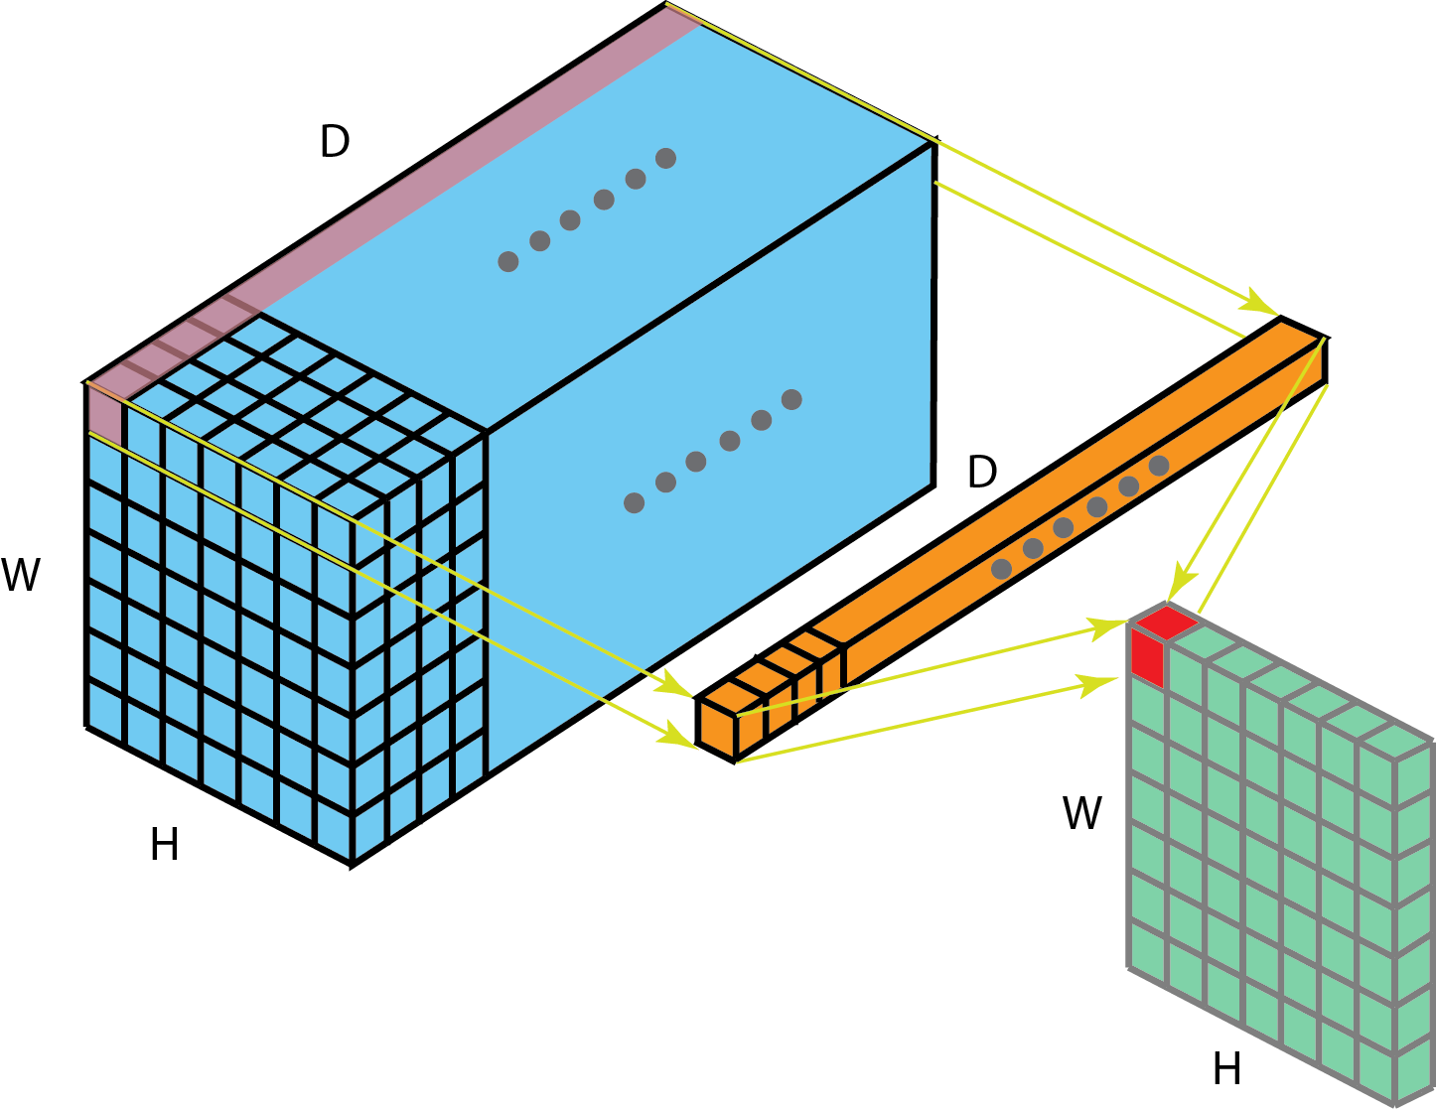
The Point-Wise Convolutions. The Workhorse of Modern day CNN’s.
1 x 1 convolution, where the filter size is 1 x 1 x D

Slide 41
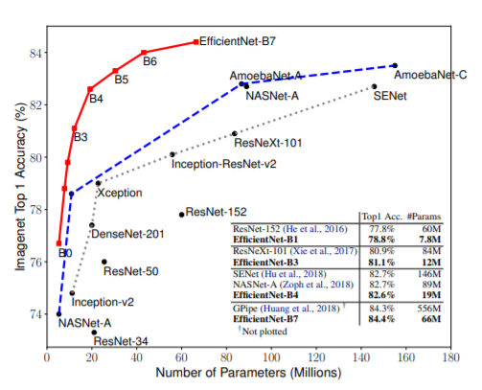
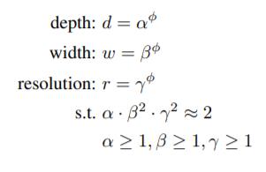
EfficientsNets are they really Efficient?

Slide 42

Understanding the Efficiency:

